Slide 1
Cater extract
Presented by:
Arkadi Doktorovich, Hen Mandelbaum

Slide 2
Motivation
Business agreements are often finalized through email thread negotiations, Important contractual details are embedded implicitly across several messages making manual extraction time consuming and error prone.
The goal of this project is to automatically extract structured contract attributes from catering email threads and output them in a fixed JSON schema.

Slide 3
Project definition
Input: Multi-turn catering email threads
Output: Fixed JSON contract schema
For models we used a LLM that uses a prompt (GPT 4-o-mini for zero-shot and few-shot), supervised Transformer (DistilBERT multi-head).
For the Dataset we created 1,000 synthetic but realistic email threads with aligned JSON ground truths.
The metrics used are Field level exact match / overlap scores, regression tolerance accuracy, multi label F1, and overall average score.

Slide 4
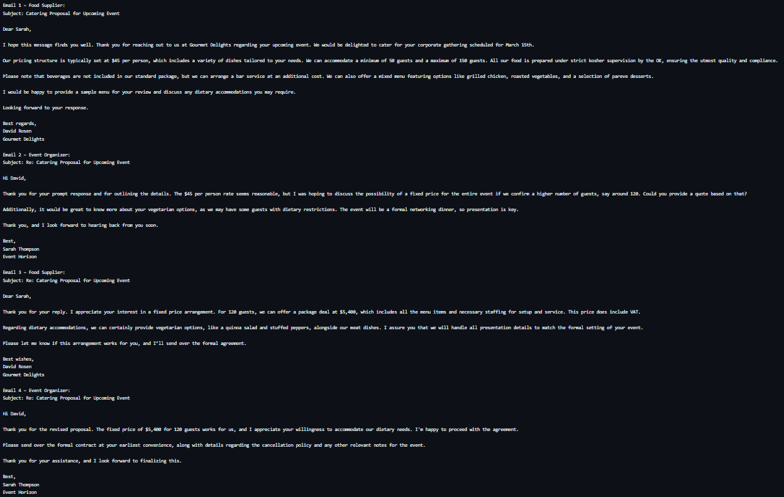

Slide 5
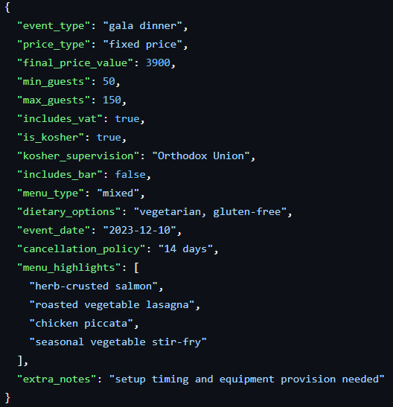
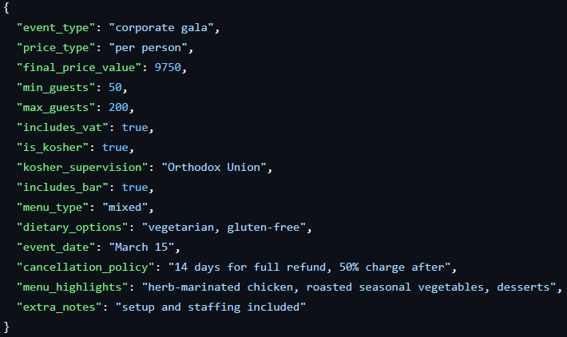

Slide 6
Feature Schema
Feature Name | Outcome Type | Possible Values / Description
event_type | Categorical (Text) | String describing event type or null
price_type | Categorical (Enum) | per_person, fixed, range, unknown
final_price_value | Numerical | Price value or null
min_guests | Numerical | Minimum number of guests or null
max_guests | Numerical | Maximum number of guests or null
includes_vat | Boolean | true, false, or null
is_kosher | Boolean | true, false, or null
kosher_supervision | Categorical (Text) | Supervision authority or null
includes_bar | Boolean | true, false, or null
menu_type | Categorical (Enum) | meat, dairy, mixed, pareve, unknown
dietary_options | Multi-Label Categorical | Array of dietary strings (e.g., vegan, gluten-free)
event_date | Temporal (Date) | YYYY-MM-DD or null
cancellation_policy | Categorical (Text) | Policy description or null
menu_highlights | Multi-Label Categorical | Array of highlighted menu items
extra_notes | Free Text | Additional notes or null

Slide 7
Feature Negotiation
Our task is not to extract mentions, but to extract the final agreed values.
Here is an example of values ​​where the values ​​change as the negotiation progresses.
Email # | Sender | Price Type | Price Value | Guests | Includes Bar | Dietary Options | Cancellation Policy
1 | Supplier | Per Person | $75 | 50–150 | No | Vegetarian | Not specified
2 | Organizer | Per Person | Request discount | 100 | Asked | Vegetarian, Gluten-Free | Asked
3 | Supplier | Per Person | $70 | 100 | Optional | Vegetarian, Gluten-Free | 30 days full refund
4 | Organizer | Per Person | $70 | 100 | Yes | Vegetarian, Gluten-Free | Accepted

Slide 8
Data Creation Pipeline
Goal: Generate realistic business email negotiations with structured ground truth.
Synthetic email threads were generated using a large language model to simulate negotiations between a food supplier and an event organizer.
Each thread contains four emails, including proposal, negotiation, clarification, and final agreement or cancellation.
Information is embedded implicitly in natural language, without explicit field labels, to mimic real world communication.
For every thread, the model outputs a structured JSON ground truth containing event attributes (e.g., price, guests, kosher status, cancellation policy).
Missing information is explicitly represented as null, enabling realistic partial information scenarios.
A total of 1,000 email threads were generated, split into email text files and corresponding JSON labels.
Outcome: A controlled yet realistic dataset for structured information extraction from negotiation style emails.

Slide 9
Multi-Task DistilBERT Feature Extractor
Model Architecture:
Backbone: DistilBERT encoder for contextual text representation.
Multi-head output layers for different prediction types:
  Classification (event type, price type, menu type, cancellation policy)
  Binary prediction (VAT, kosher, bar inclusion)
  Regression (final price, guest counts, event date)
  Multi-label classification (dietary options, menu highlights, extra notes)
Masked mean pooling over token embeddings to obtain document level representation.
Training Setup:
Multi-task learning with task specific loss functions (cross-entropy, MSE, BCE).
Field specific loss weighting to balance heterogeneous outputs.
Numeric fields normalized to stabilize training.

Slide 10
Achievements and Novelty
Accomplishments:
Trained a supervised extraction model that outperformed zero-shot and few-shot LLMs on structured feature extraction.
Finding a close to perfect prompt for business email threads generation.
Novelty:
Focus on negotiation aware information extraction rather than single email or sentence level extraction.
Direct comparison between LLM based extraction and supervised multi-task learning under the same schema.

Slide 11
Methodology
Project process:
Defined a structured schema and aligned all models to the same output format.
Trained, evaluated, and compared multiple extraction approaches.
Data & Models:
Prepared a dataset of 1000 synthetic email thread negotiations with JSON ground truth.
Evaluated:
  GPT 4-o-mini, LLM zero-shot & few-shot prompting.
  Zero-Shot : use Only instructions and schema.
  Few- shot : Use One full example Email thread and JSON output.
  DistilBERT, Supervised Transformer based model.
Metrics: field-level Precision, Recall, and F1-score.
Efforts:
Training from ground zero the Supervised Transformer based model.
Prompt engineering and consistency checks for LLM outputs and data creation.

Slide 12
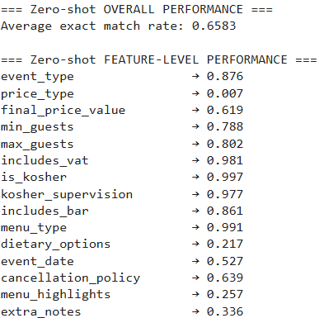
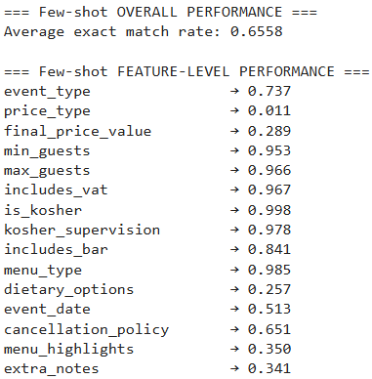
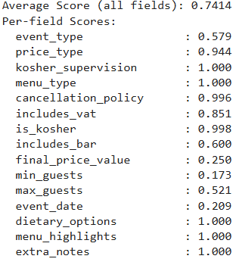
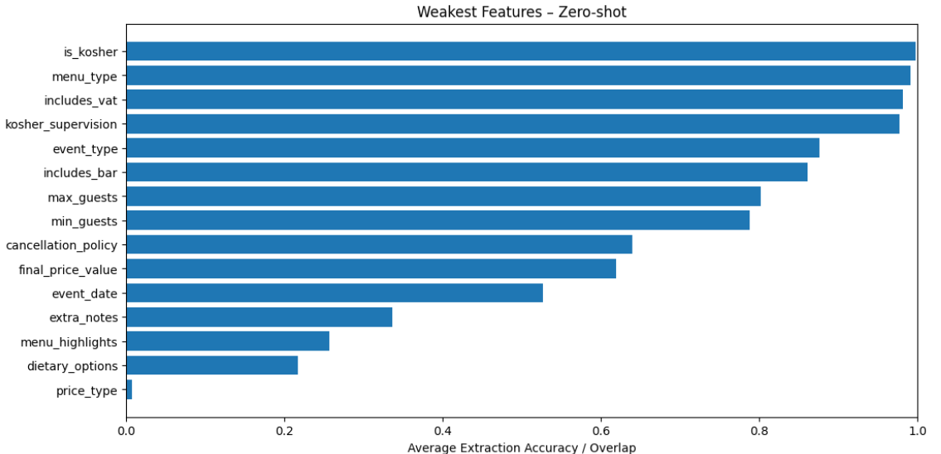
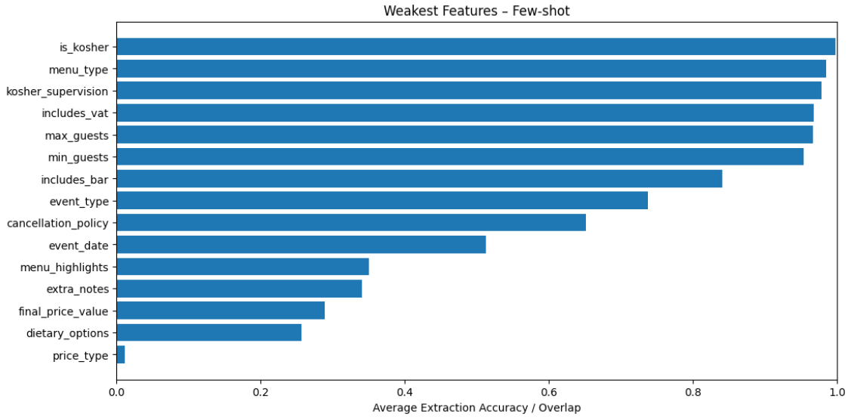
Results

Slide 13
Conclusion
Our goals were to outperform the LLM models, and we successfully did it after working on the supervised transformer-based model.
Things we learnt:
Schema design and annotation consistency are as critical as model choice.
Prompting alone is insufficient for high precision structured extraction.
Additional ideas:
Hybrid approaches combining LLM reasoning with supervised extraction.
Expand dataset size and include real world negotiation data.

